Slide 1
I thought DLP was supposed to fix this
Amit Riswadkar (FeMaven)

Slide 2
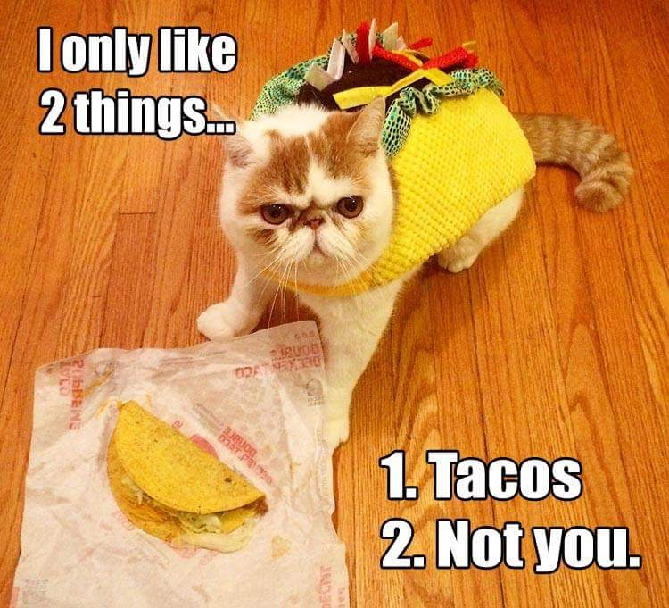
About me (or why you should listen to me)
Done a lot of different types of DLP projects
Design
Implementation
Ops
Interests
Data analytics
Rock climbing, running
Tacos
On social media on @FeMaven
Obligatory Disclaimer: my thoughts don’t reflect the thoughts and opinions of my employer

Slide 3
What this not and Is Not
What this is not:
A position that DLP is useless
A suggestion on what vendor’s stuff to buy
About UEBA/UBA
What this is:
A data (governance) centric view towards data protection
Using data analytics for actionable intelligence

Slide 4
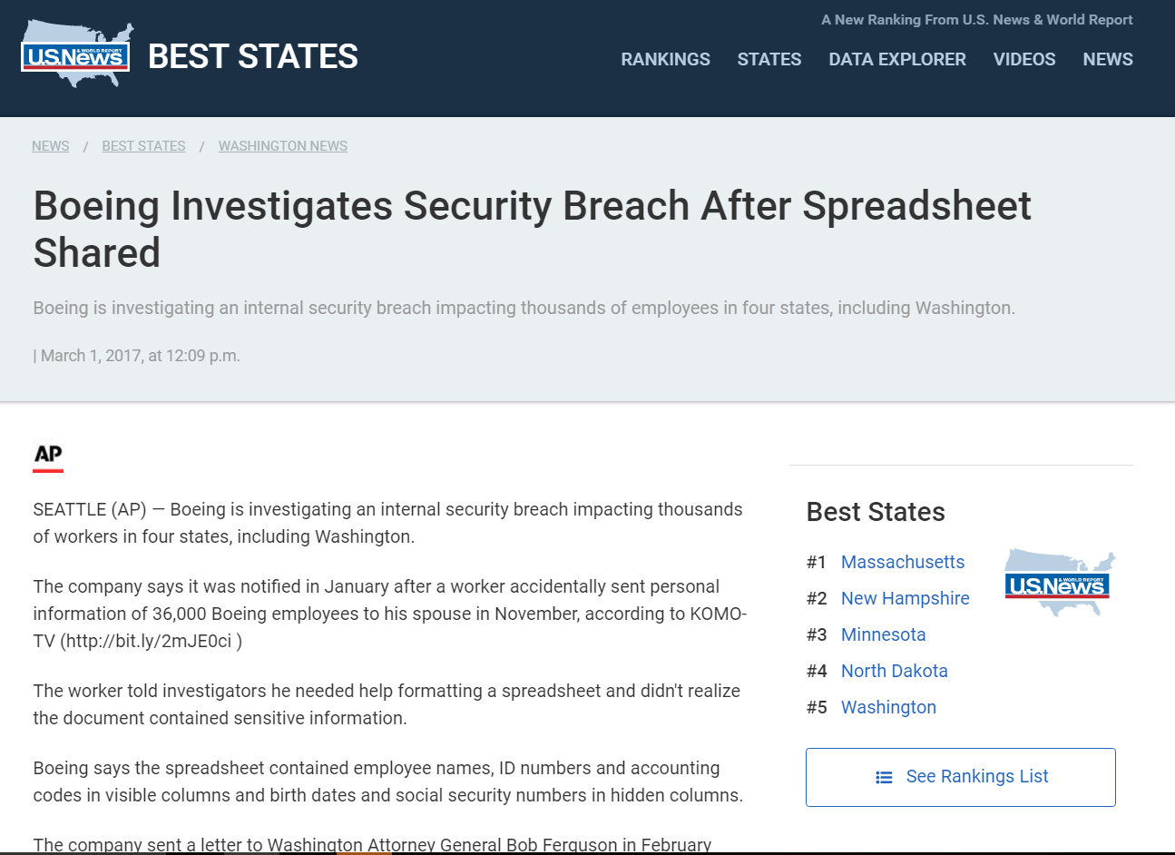
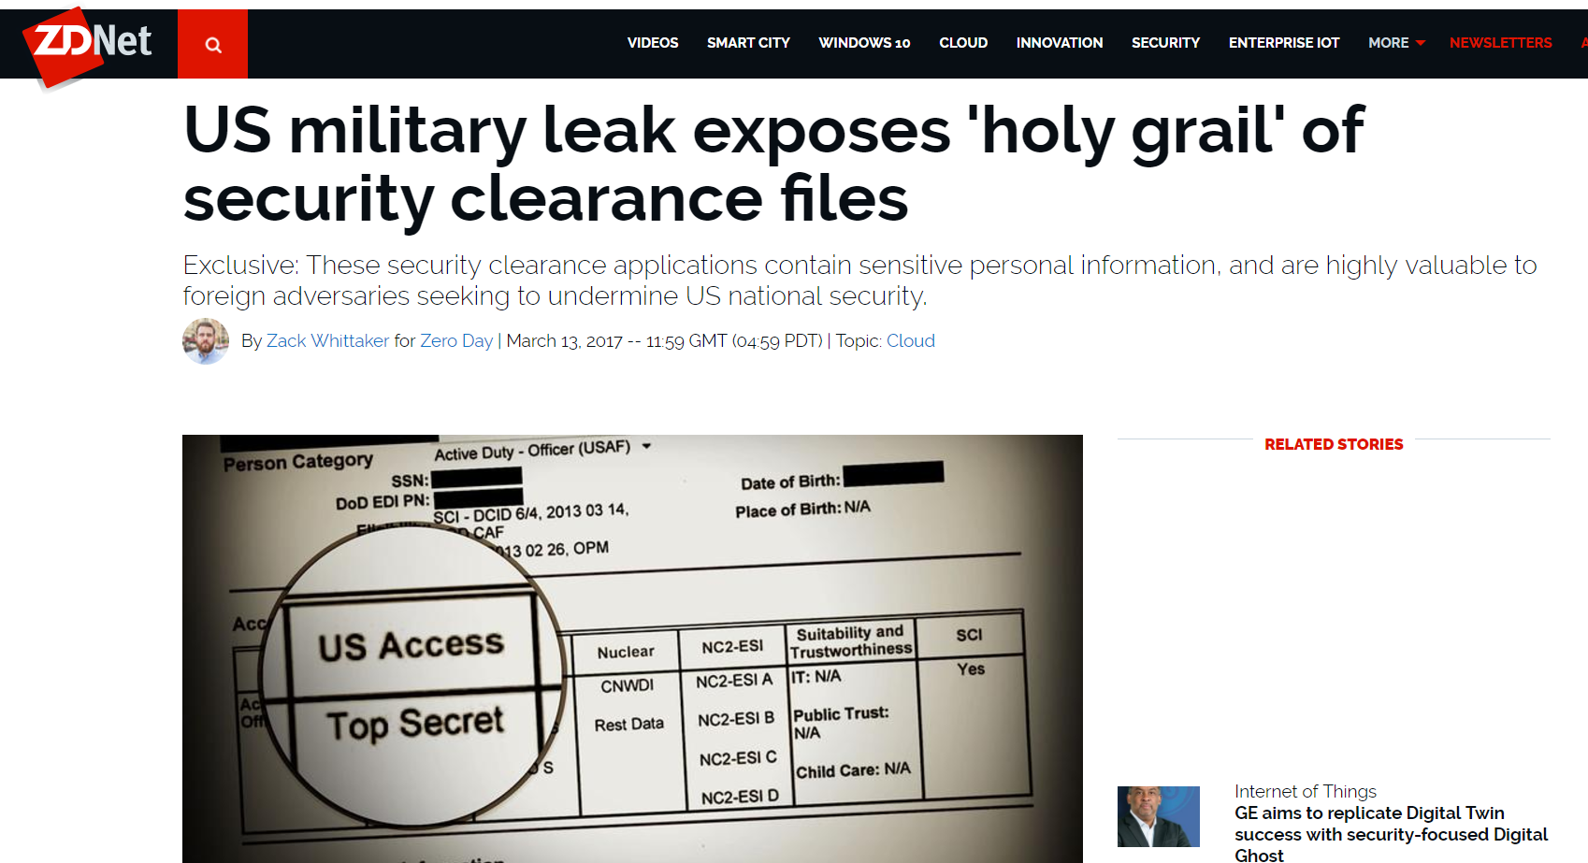
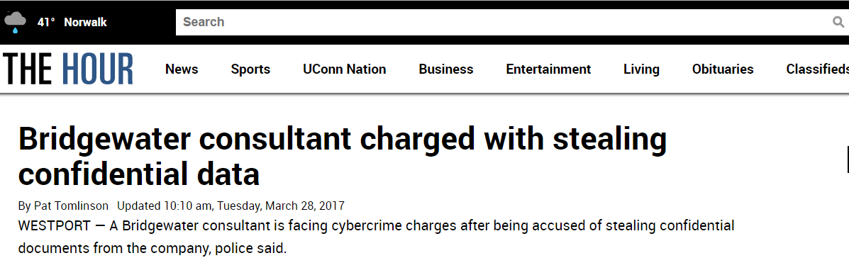
WHY dlp (STILL) MATTERS
~60% of users have admitted to taking sensitive data from a previous employer (Ponemon Institute 2009)
Depending on industry, may be target of nation state/industrial espionage
Required for many regulations
Sources:
https://www.forcepoint.com/newsroom/2016/forcepoint-and-ponemon-institute-survey-finds-organizations-challenged-when-monitoring
https://www.usnews.com/news/best-states/washington/articles/2017-03-01/boeing-investigates-security-breach-after-spreadsheet-shared
http://www.zdnet.com/article/leaked-us-military-files-exposed/
http://www.thehour.com/news/article/Bridgewater-consultant-charged-with-stealing-11028883.php

Slide 5
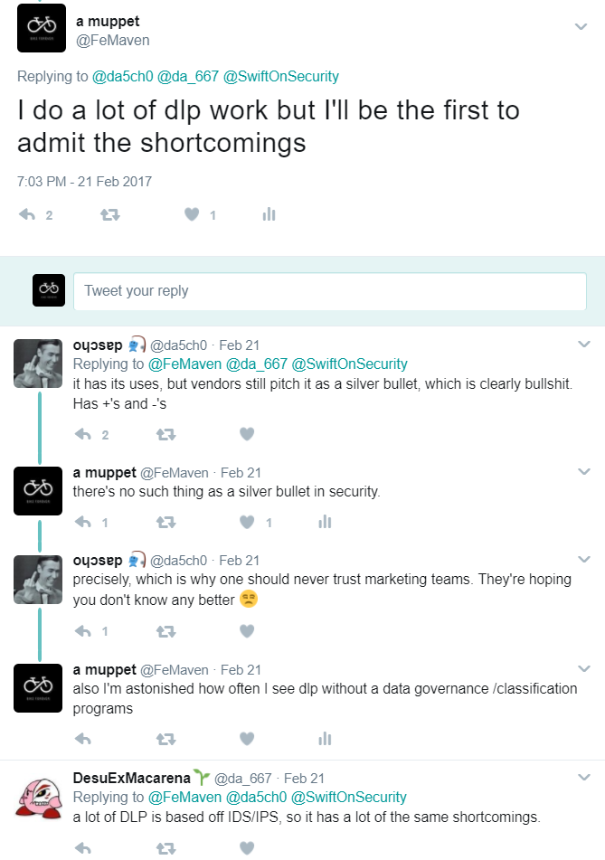
Problems and challenges
Technology
End user impacts
Mobile
Reporting
Agent Management
Organization
Fragmented data protection strategy
Data sprawl
Operations
Scaling
Tuning
Skills
Regulatory Reqs
EU GDPR (General Data Protection Regulation)
GLBA (Gramm-Leach-Bliley Act)
PCI, where efforts are check the box
And lots of others

Slide 6
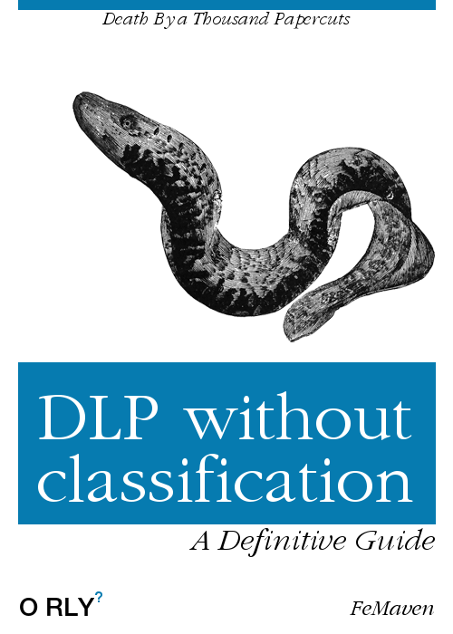
Recipe for Data protection 1/2
Data governance and classification
Identify where org’s critical data in structured and unstructured data is created and lives
Duplication of data/orphaned data
Aggregation and Analytics
Correlation against other sources
Show movement of data from authoritative source e.g. app, DB, ECM
Seasonal trends based on org structure
Effectiveness of controls

Slide 7
Recipe for Data protection 2/2
Stakeholder Engagement
Remediation of insecure business processes
Identify additional use cases
Automation
Classification of data at rest
Encryption of data at rest
Data Lifecycle
Unstructured data
Sensitive data
Structured data
Orphaned Data

Slide 8
Thank You!!!
Slides will be posted on https://github.com/femaven/security_talks/

